Slide 1
BENEFICIAL INTEREST
CORN HILL CONDOMINIUM ASSOCIATION

Slide 2
BENEFICIAL INTEREST
Introduction
What is Beneficial Interest?
Beneficial interest is the percentage of ownership that the owner of each condominium unit is entitled to in the common areas and facilities of a condominium.
Importance: It influences many essential parts of condominium governance, from budgeting to voting.
Also sometimes referred to as “undivided interest,” beneficial interest is typically listed by unit in an exhibit or schedule to the master deed of a condominium. The beneficial interest of each unit must also be listed in the unit deed, pursuant to the Massachusetts Condominium Statute, General Laws Chapter 183A (“Chapter 183A”), Section 9. The total of all unit beneficial interests should add up to one hundred percent, that is, one hundred percent of the ownership of the common areas.

Slide 3
Development of Beneficial Interest
Setting Beneficial Interest: Developers set the beneficial interest of each unit as units are created in the master deed.
Legal Framework: According to Chapter 183A, Section 5, the beneficial interest of each unit is in the approximate relation that the fair value of the unit on the date of the master deed bears to the then aggregate fair value of all the units.

Slide 4
Establishing Beneficial Interest
Master Deed: Beneficial interest is typically listed by unit in an exhibit or schedule to the master deed of a condominium.
Unit Deed: The beneficial interest of each unit must also be listed in the unit deed.
Voting Rights: Each unit owner is entitled to vote in the amount of their beneficial interest.

Slide 5
Meaning and Implications of Beneficial Interest
Voting Power: A unit with a higher beneficial interest has a greater say in all voting decisions.
Quorum: Beneficial interest is used to calculate quorum for meetings.
Common Charges: It is also used to set each individual unit owner’s monthly condominium common charge.

Slide 6
Assignment and Determination of Percentage Interests
Each Unit owner shall be entitled to an undivided interest in the common areas and facilities in the % set forth in the master deed
shall be in the approximate relation that the fair value of the unit on the date of the master deed bears to the then aggregate fair value of all the units.
G.L. c 183A §5(a) criteria - unit size, unit’s position in a building, view and architectural detail.
Note: statute does not require exactitude -

Slide 7
G.L c 183A § 5(b)
The percentage of the undivided interest of each unit owner in the common areas and facilities as expressed in the master deed shall not be altered without the consent of all unit owners whose percentage of the undivided interest is materially affected.
Note: regardless of language in the Master Deed governing the amendment thereof, the percentage interest cannot be changed without the consent of the owners of the units whose percentage will be affected

Slide 8
Declaration of Trust – Legal document establishing the Condo Association and Outlines its Purpose and Structure Created May 21st 1980 by Diane Lafrance as Trustee Set out Name of Trust- Corn Hill Cottages Condominium Trust The Trust and Its Purpose- sets out and governs the legal framework of the condominium operations and Trustees, specifies the purposes of the Association, rules for managing common areas and financial obligations Article IV – Beneficial Interest in the Trust – “the BI in the trust here-under shall be divided among the Unit Owners in the percentages of undivided BI appertaining to the Units of the Condominium”

Slide 9
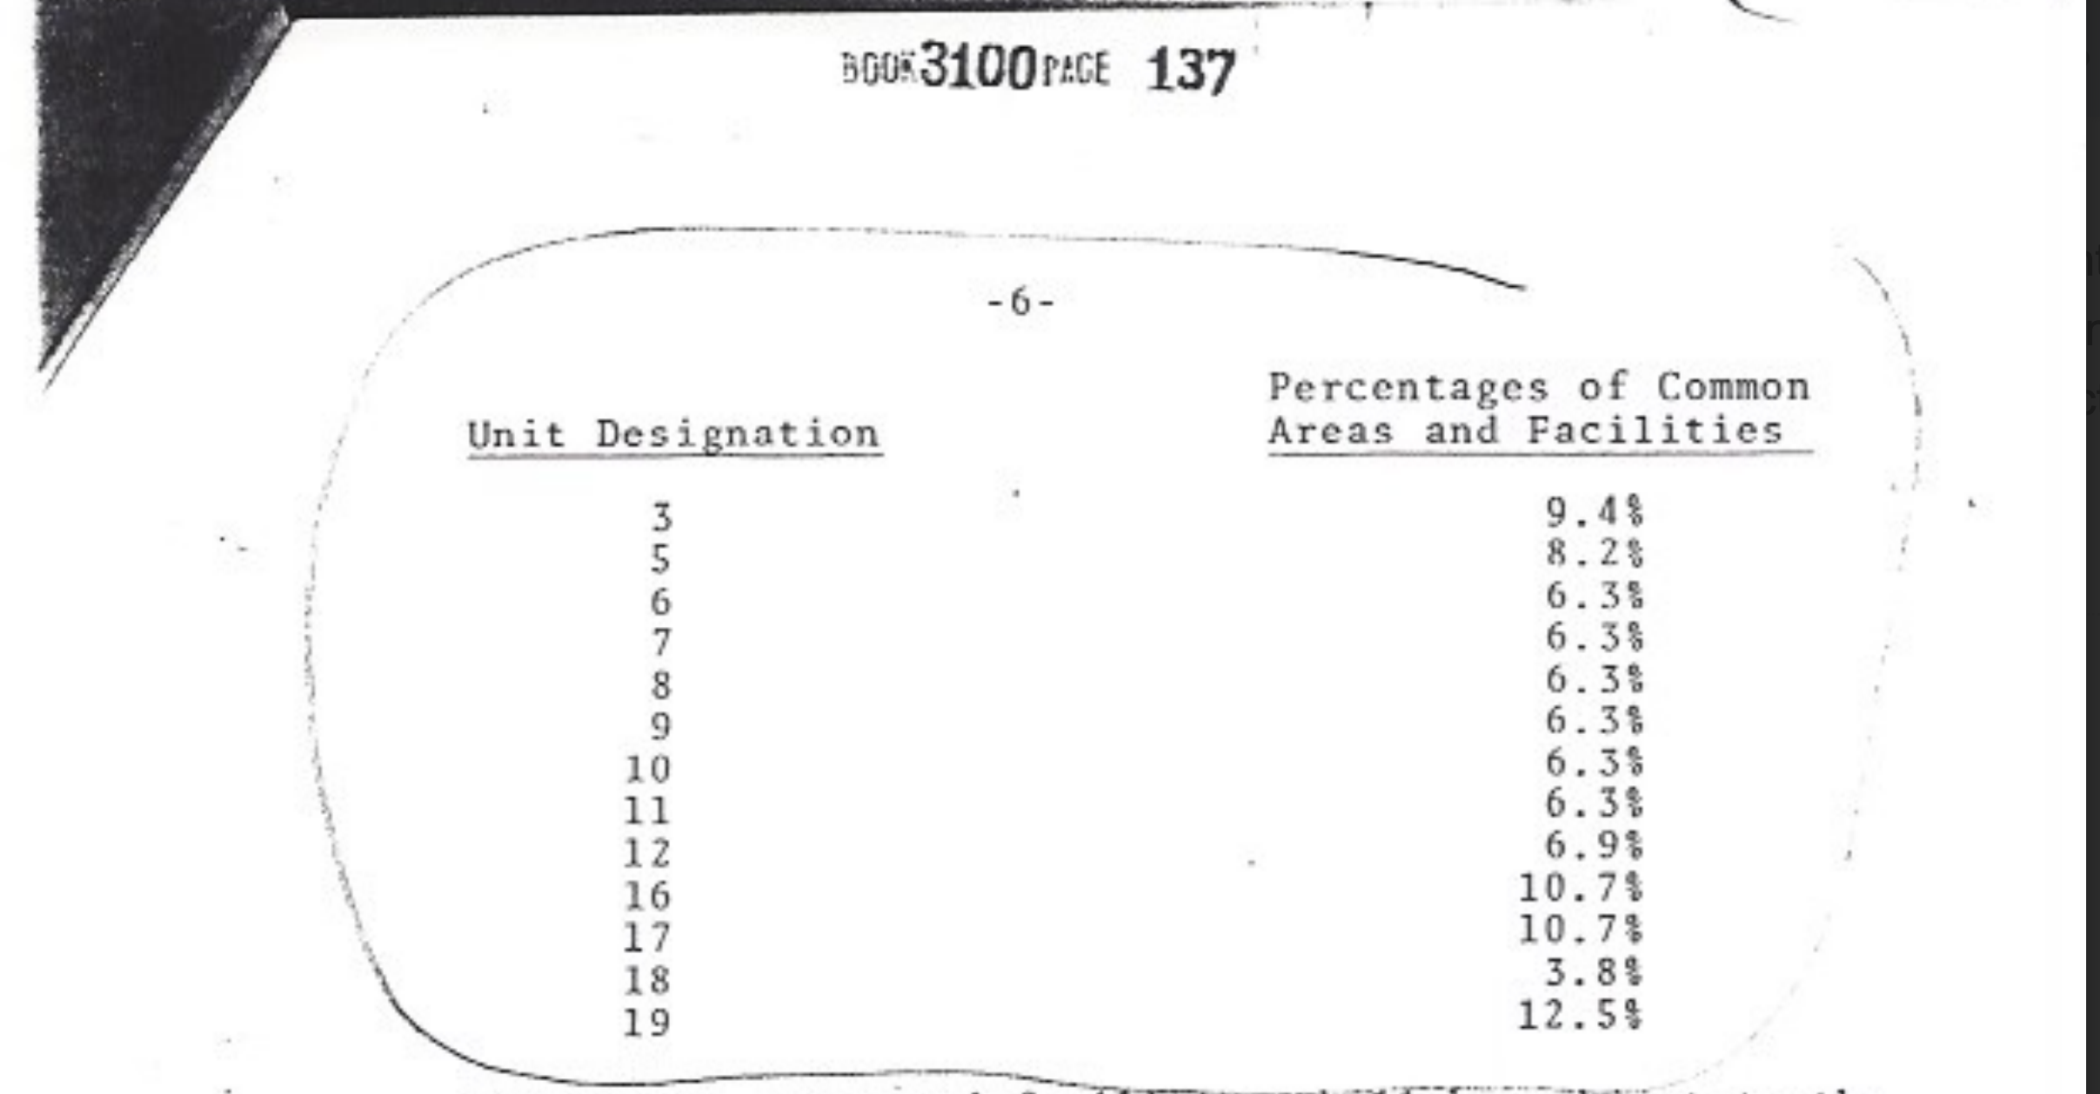

Slide 10
Exhibit B --- Master Deed (1980)
Note: Approximate area included porches and decks which are not generally
considered when determining the square footage of the interior of a dwelling.

Slide 11
Continued
When the cottages were converted into condominium ownership in 1980 by Diane La France, condominiums were a fairly new concept and law. We think her and her attorney’s choices in establishing Beneficial Interest for the condos were somewhat idiosyncratic.
The measurements for square footage of the cottages included decks and porches. This is not the current standard as to how living area should be measured for any real estate purposes; whether for appraisers, assessors, marketing, or insurance evaluations. Hence, our look at the Town of Truro’s Assessors present-day measurements of the units, and comparing the value of each unit to the overall total value of all the units.

Slide 12
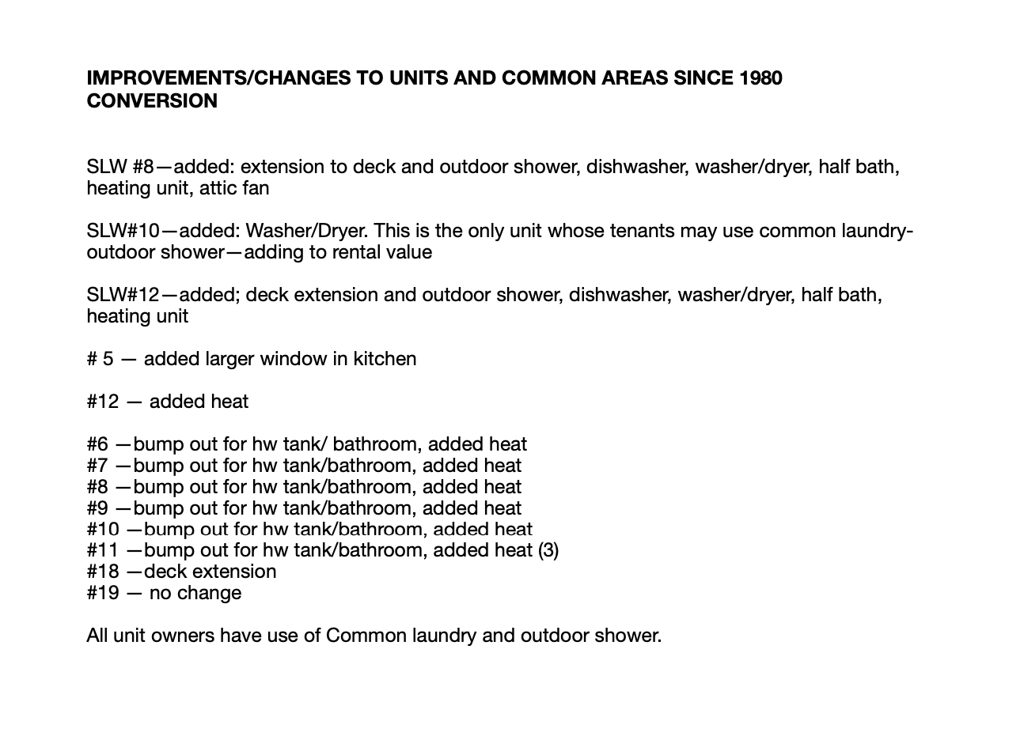

Slide 13
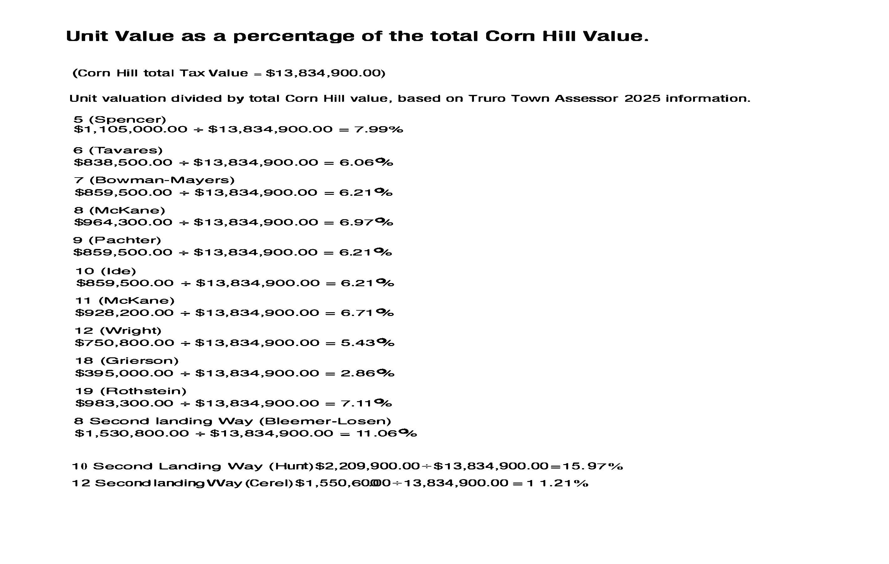

Slide 14
Conclusion
Reviewing the beneficial interest can be a pivotal step in ensuring equity, transparency and adaptability.
BI directly affects the rights and responsibilities of unit owners –voting power & financial obligations (assessments for maintenance & capital improvements).
Changing established BI is rare, likely because relative values in Associations don’t move very much. Although we spoke to a couple of attorneys specializing in conveyancing condominiums, we could not find any examples of associations where the BI were modified.
After consulting with an attorney and reviewing the relevant statue, we find nothing in the law that requires a change in the BI nor is there anything that prohibits a change.

